Slide 1
Image Registration

Slide 2
Image Registration
Image registration is the process of aligning two or more images of the same scene.
Typically, one image, called the base image or reference image, is considered the reference to which the other images, called input images, are compared.
The object of image registration is to bring the input image into alignment with the base image by applying a spatial transformation to the input image.
Image registration is often used as a preliminary step in other image processing applications. For example, you can use image registration to align satellite images of the earth’s surface or images created by different medical diagnostic modalities (MRI and SPECT).
  After registration, you can compare features in the images to see how a river has migrated, how an area is flooded,
  or to see if a tumor is visible in an MRI or SPECT image.

Slide 3
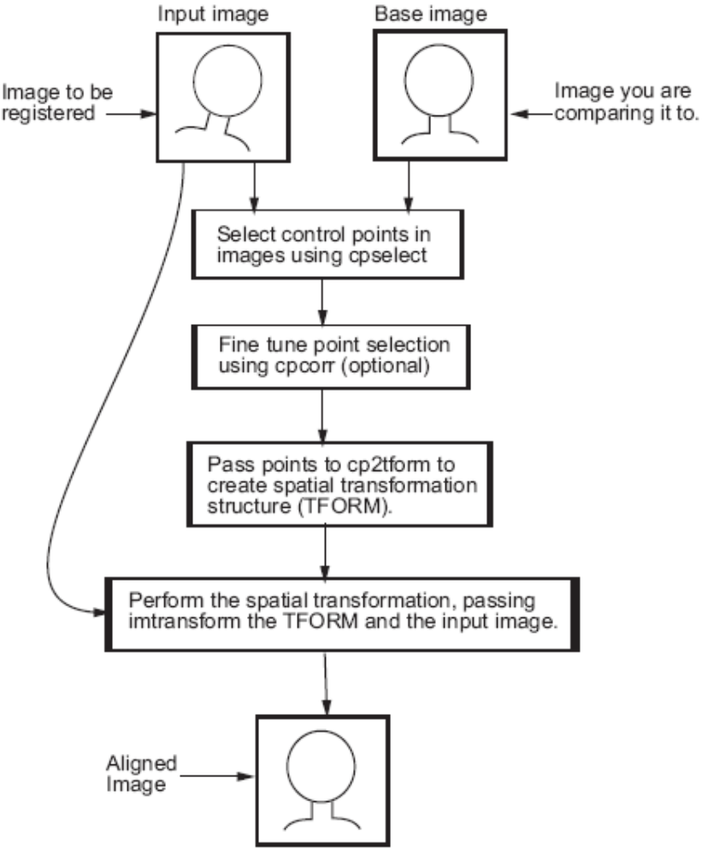

Slide 4
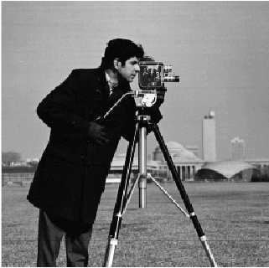
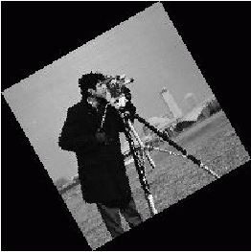
Finding the Rotation and Scale of a Distorted Image
I = imread('cameraman.tif');
figure, imshow(I)
J = imresize(I,0.6);
K = imrotate(J,30);
figure, imshow(K)

Slide 5
Select Control Points & Find a TFORM structure
Use cpselect to pick at least two pairs of control points.
cpselect(K,I);
Save control points by choosing the File menu, then the Save Points to Workspace option.
Save the points, overwriting variables input_points and base_points
Find a TFORM structure that is consistent with your control points.
t = cp2tform(input_points,base_points,'linear conformal');
Repeat but try using 'affine' instead of 'linear conformal'. What happens? Are the results as good as they were with `linear conformal'?

Slide 6
For linear conformal transformation, calculate scale and angle from the TFORM structure.
ss = t.tdata.Tinv(2,1);
sc = t.tdata.Tinv(1,1);
scale = sqrt(ss*ss + sc*sc)
angle = atan2(ss,sc)*180/pi
scale =
0.5952
angle =
30.0914

Slide 7
Recover Original Image
recovered = imtransform(K,t);
figure, imshow(recovered);

Slide 8
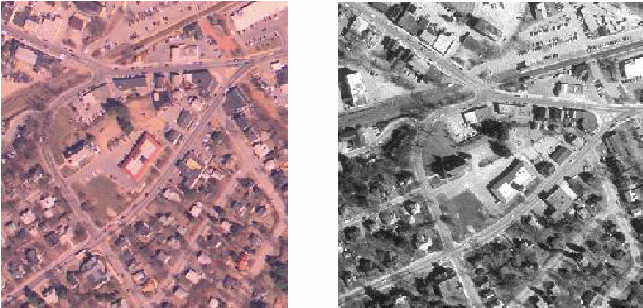
Registering an Aerial Photo to an Orthophoto
unregistered =mread('westconcordaerial.png');
figure, imshow(unregistered)
figure,imshow('westconcordorthophoto.png')

Slide 9
Choose Control Points
The unregistered image is an RGB image but cpselect only takes grayscale images, so you will pass it one plane of the RGB image.
load westconcordpoints % load some points that were already picked
cpselect(unregistered(:,:,1),'westconcordorthophoto.png',input_points,base_points)
Calculate the Geometric Transformation
t_concord = cp2tform(input_points,base_points,'projective');

Slide 10
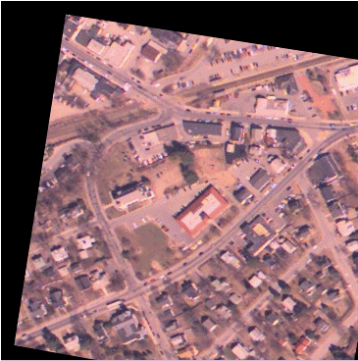
Transform Unregistered Image
Even though the points were picked on one plane of the unregistered image, you can transform the entire RGB image.
imtransform will apply the same transformation to each plane.
Note that the choice of 'XData' and 'YData' values ensures the registered image will be aligned with the orthophoto.
info = imfinfo('westconcordorthophoto.png');
registered = imtransform(unregistered,t_concord,...
'XData',[1 info.Width], 'YData', ...
[1 info.Height]);
figure, imshow(registered)

Slide 11
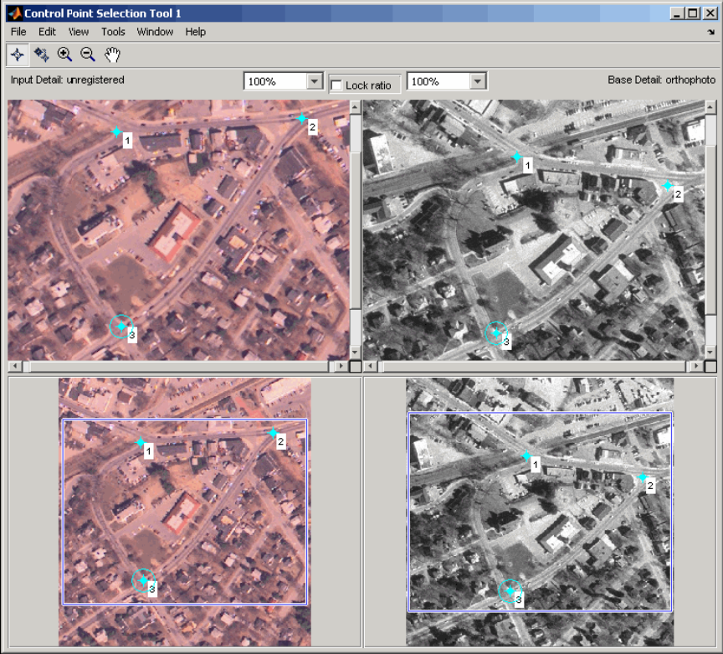
**Presentation Assignment
Explain
aerial = imread('westconcordaerial.png');
cpselect(aerial(:,:,1),'westconcordorthophoto.png')
Save the Control Point Pairs to the MATLAB Workspace

Slide 12
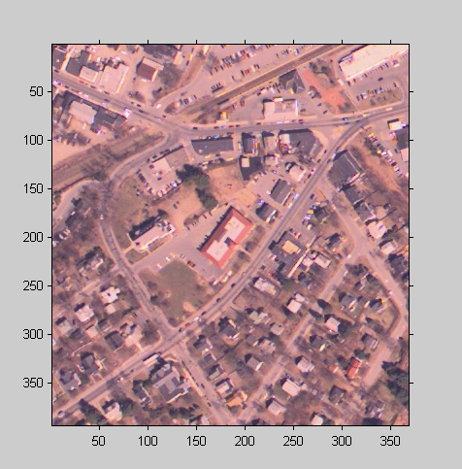
Performing Image Registration
Read in Base and Unregistered Images
  base = imread('westconcordorthophoto.png');
  unregistered = imread('westconcordaerial.png');
Display the Unregistered Image
  iptsetpref('ImshowAxesVisible','on')
  imshow(unregistered)
Create a TFORM structure using preselected control points.
  Start by loading a MAT-file that contains preselected control points for the base and unregistered images.
load westconcordpoints
tform = cp2tform(input_points, base_points, 'projective');

Slide 13
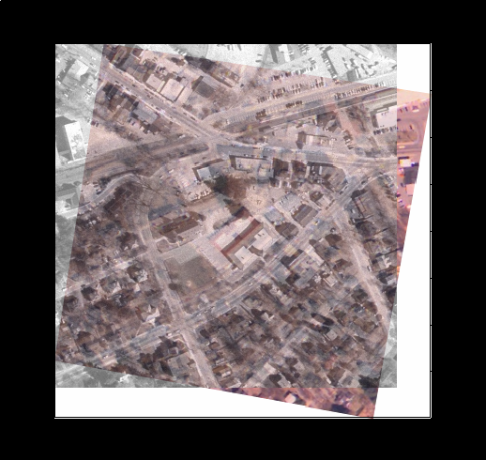
Transform the unregistered Image
registered = imtransform(unregistered, tform, 'FillValues', 255);
Overlay Registered Image Over Base Image
  figure; imshow(registered);
  hold on
  h = imshow(base, gray(256));
  set(h, 'AlphaData', 0.6)
  Notice how the two images appear misregistered because the example assumes that the images are in the same spatial coordinate system.

Slide 14
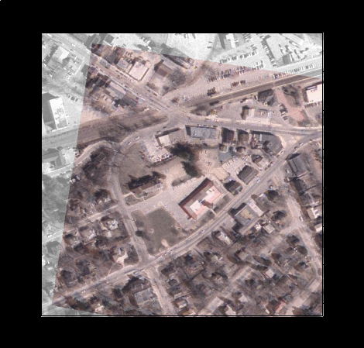
Using XData and YData Input Parameters
  One way to ensure that the registered image appears registered with the base image is to truncate the registered image by discarding any areas that would extrapolate beyond the extent of the base image.
  You use the 'XData‘ and 'YData' parameters to do this.
registered1 =
imtransform(unregistered,tform,...
'FillValues', 255,...
'XData', [1 size(base,2)],...
'YData', [1 size(base,1)]);
figure; imshow(registered1)
hold on
h = imshow(base, gray(256));
set(h, 'AlphaData', 0.6)

Slide 15
**Presentation Assignment
Use Examples!
cp2tform
  global transformations
    'linear conformal'
    'affine'
    'projective'
    'polynomial' (Order 2, 3, or 4)
  local transformations
    'piecewise linear'
    'lwm'

Slide 16
**Presentation Assignment
Registering an Image Using Normalized Cross-correlation
The demo includes these steps:
  Step 1: Read Image
  Step 2: Choose Subregions of Each Image
  Step 3: Do Normalized Cross-Correlation and Find Coordinates of Peak
  Step 4: Find the Total Offset Between the Images
  Step 5: See if the Onion Image was Extracted from the Peppers Image
  Step 6: Pad the Onion Image to the Size of the Peppers Image
  Step 7: Transparently Overlay Onion Image on Peppers Image

